Slide 1
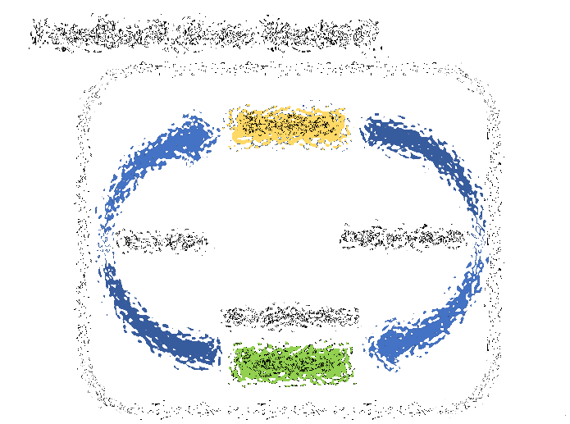
Event Derivatives and Electoral Feedback
“Early in life I had noticed that no event is ever correctly reported in a newspaper…”
― George Orwell
Anarcapulco 2019
Paul Sztorc
truthcoin.info
Version 2.0 16 Feb 2019

Slide 2
About Me
Southern CT
Case Western: BA Economics, MS Applied Math, MBA
Consulting
Yale Econ Department, Statistician, pre-PhD
Bitcoin
Truthcoin.info blog,
Scaling Bitcoin I, II, III and IV; TABconf and BoB.
Notes:
Hello, my name is Paul Sztorc. I have a relatively mainstream background – public school in Connecticut for 12 years, private engineering college in Ohio, where I studied economics and statistics. I then worked a kind of pre-doctoral research statistician job at Yale for 2 years for a man named William Nordhaus, who just won the economics Nobel Prize a few months ago. So my economic training is quite mainstream.
Despite all of that, I fell in love with Bitcoin in 2012. I’ve published Bitcoin research on my blog “truthcoin.info” since 2014. I presented at many Bitcoin conferences, especially the scaling conferences, as well as Building on Bitcoin (last summer) and TABConf earlier this year.

Slide 3
Improvement; NOT Replacement
Improvement
Replacement
Democracy
Markets
Democracy
Markets
Event Derivatives
Democracy
Markets
Democracy
Markets
Yes
No
Notes:
The topic of this presentation is an idea for getting the public sector to substantially inherit some of the best aspects of the private sector.
So it is NOT about replacement. It is not about replacing the public sector with the private sector. …so you have to decide how anarchist you think it is.

Slide 4
Talk, in One Slide
Problem: Politicians are installing bad policies into society, and getting away with it.
Solution: Make it easy to: detect imperfect politicians, and fire them asap.
Specifically: Create blockchain assets whose ultimate valuation reflects politician’s competence. Citizens glance at spot prices, just before voting.

Slide 5
For Example, Voter might see:
Average, over years 2020-2024… | Incumbent Party | Rival Party
Total Government Spending ($/person) | $12,568 | $10,407
Total Money Earned by all Citizens ($ billions) | $16,427 | $17,009
Total Deaths, all causes (thousands of people) | 2,917 | 2,901
better
Slightly better
basically the same
Notes:
Personal Income
https://www.statista.com/statistics/216756/us-personal-income/

Slide 6
Agenda
Background
Electoral Feedback
Event Derivatives
Synthesis
Why Laypeople Will Care
Long Long Long Short Short

Slide 7
Background Knowledge
Idea has intellectual history.
(At least) one decent project exists.
No ICO, No Utility Token

Slide 8
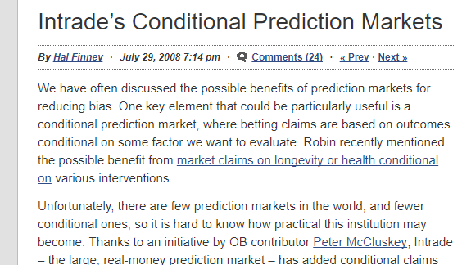
Name-Dropping: Finney, Merkle
“There are only a few people alive today worth listening to. Robin Hanson is one of them.”
– Ralph Merkle, co-inventor of asymmetric (public/private) key cryptography, inventor of cryptographic hashing, and of the Merkle tree.
Notes:
This idea was also championed by Hal Finney, who many people believe to be Satoshi Nakamoto.
The second quote is from Ralph Merkle, who invented a lot of the technology *in* Bitcoin. He is praising Robin Hanson, this is basically his Futarchy idea, just on a blockchain.

Slide 9
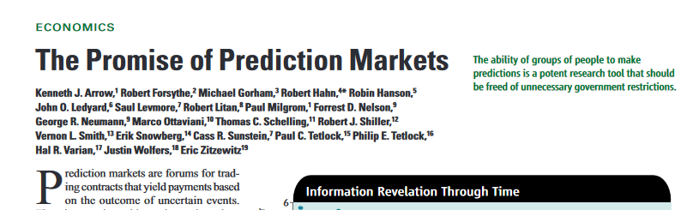
More Supporters
Notes:
Of course, the high road moving at a snail’s pace, hence this blockchain project.

Slide 10
We Need at Least One Solution, to the Blockchain Oracle Problem
Hivemind
Amoveo
Augur
Event Derivatives
Today
Gnosis
(The Goal)
Website bitcoin.com/oracle
Abra (?)
Notes:
This project has quite a bit of context. Which I think is important for you to know, so I’m sharing it. This talk is independent of any projects.
For a wide variety of reasons, I think that only the topmost project will be able to work as advertised.

Slide 11
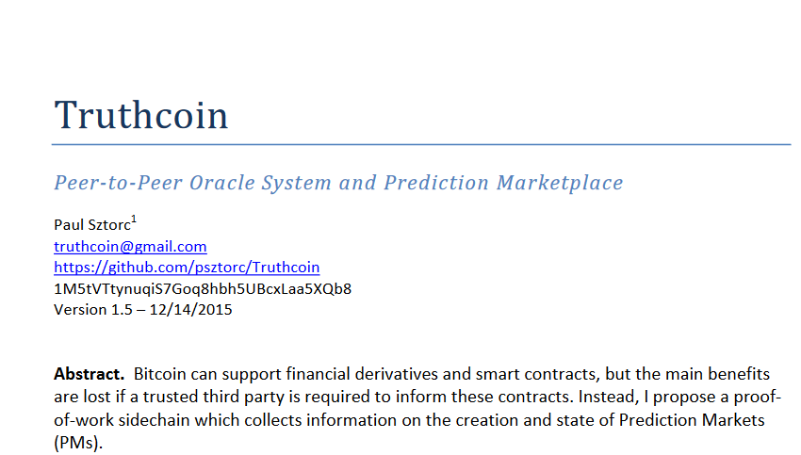

Slide 12
Paper Reviews (~2015)
“…may be the most important invention since Bitcoin itself.”
Roger Ver
“I’m very optimistic about the feasibility of this project.”
Andrew Poelstra
“…a real project with interesting use cases.”
Dr. Adam Back
“…at least it’s clever crazy rather than stupid crazy. :)”
- Peter Todd

Slide 13
Multiple Implementations
Hivemind
Amoveo
Truthcoin
Augur
Gnosis
2014
2015
2016
2017
2018

Slide 14
Multiple Implementations
Hivemind
Amoveo
Truthcoin
Augur
Gnosis
2014
2015
2016
2017
2018

Slide 15
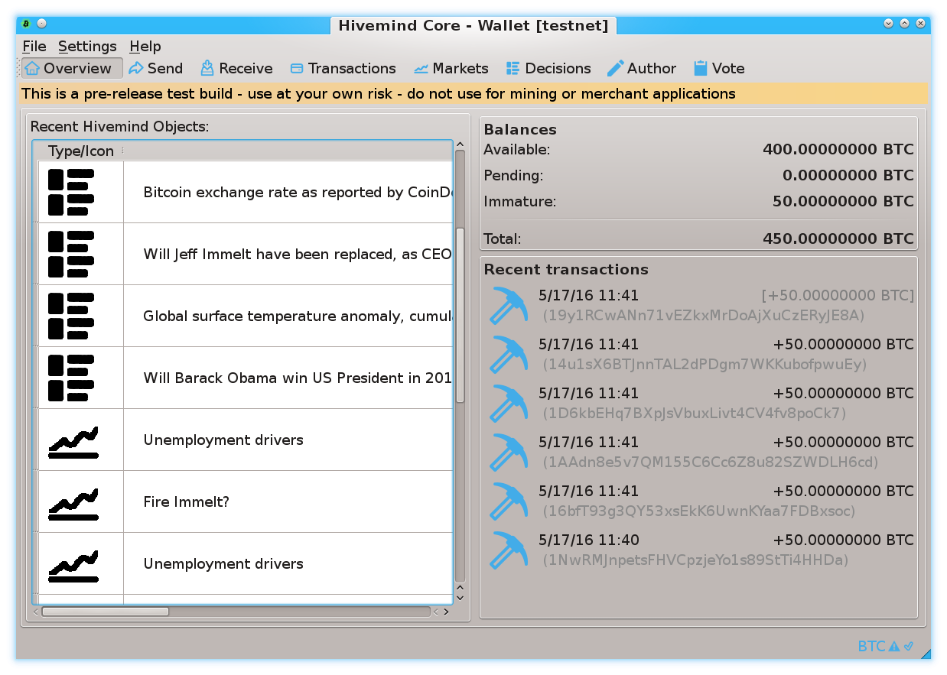
Screenshot 1

Slide 16
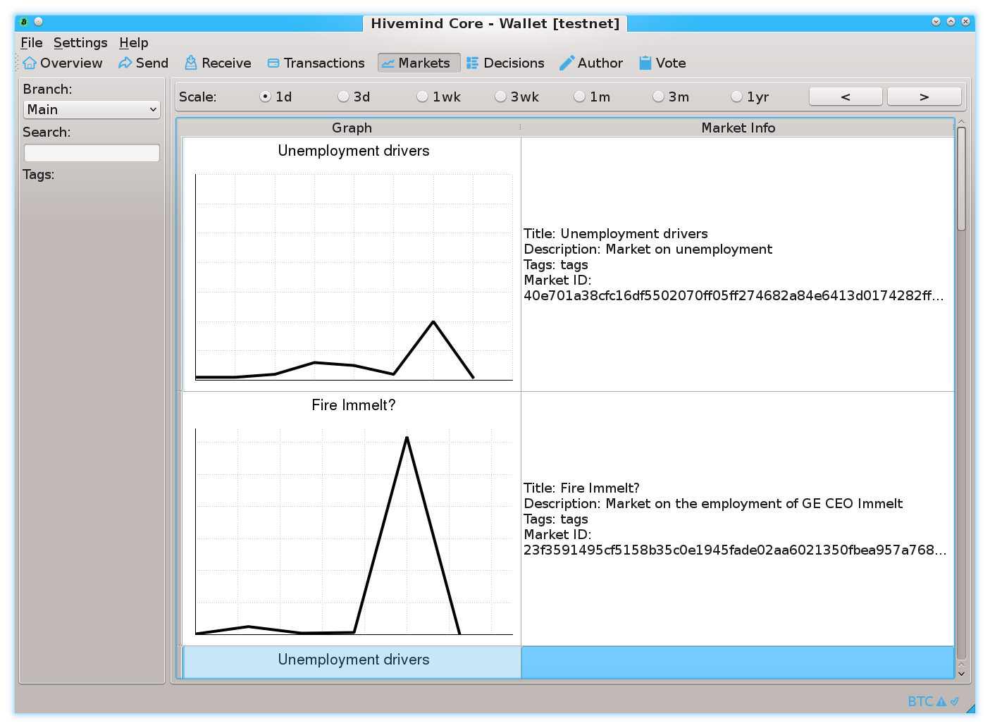
Screenshot 2

Slide 17
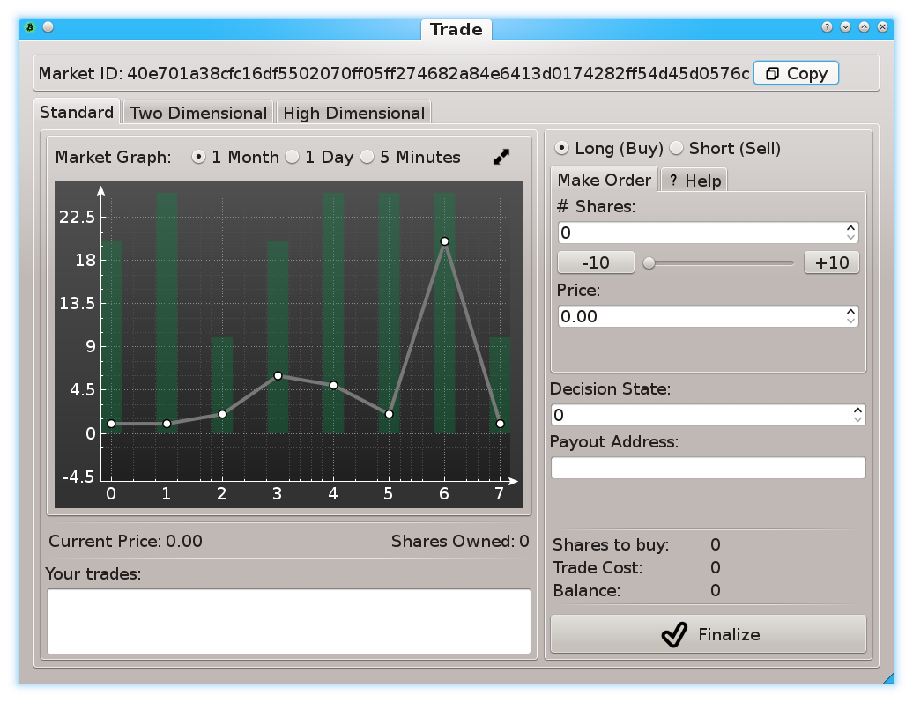
Screenshot 3

Slide 18
Background Knowledge
Idea has intellectual history.
(At least) one decent project exists.
No ICO, No Utility Token

Slide 19
Agenda
Background
Electoral Feedback
Event Derivatives
Synthesis
Why Laypeople Will Care

Slide 20
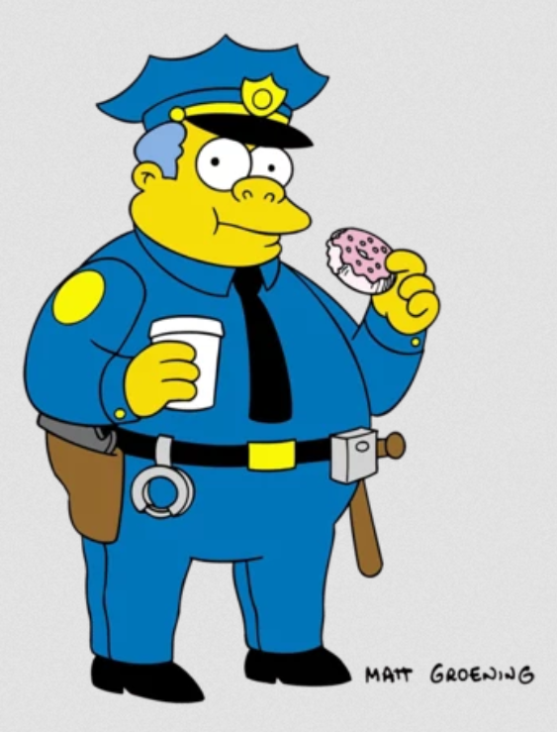
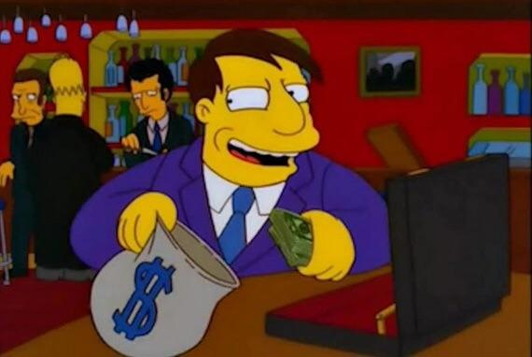
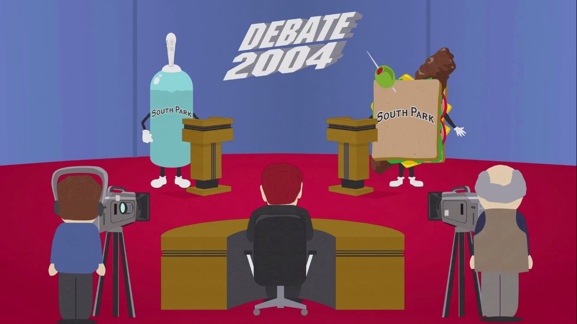
Why does the Public Sector Disappoint?
Mayor Quimby
Chief Wiggum
Giant D****h vs. T**d Sandwich

Slide 21
Feedback (Free Market)
Merchant
less sales
bad products
dissatisfaction
Consumer

Slide 22

Feedback (Democracy)
Ballot Box

Slide 23
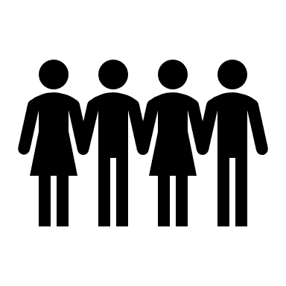
Feedback to Remove Errors
Legislative
Executive
Fired by Secret Ballot
Fired by Secret Ballot
Bad Policy
Tyranny
“The People”
“The People”

Slide 24
Post-Enlightenment Political Technology
What is allowed
Judicial
Legislative
Information-processing
Neutral 3rd party.
Decide slowly.
No other powers.
Policy-making
What to do
Enforcement
Executive
What to do
“The People”
“The People”

Slide 25
Feedback to Remove Errors
Legislative
Executive
Fired by Secret Ballot
Fired by Secret Ballot
Bad Policy
Tyranny
“The People”
“The People”

Slide 26
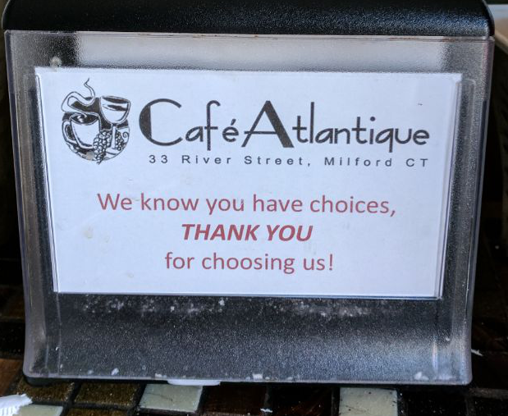
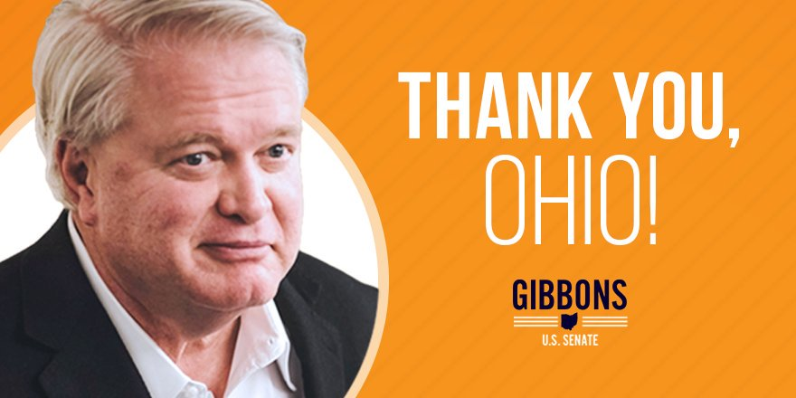
Feedback: Market vs Electoral
Frequency

Slide 27
Feedback: Market vs Electoral
Frequency
Research

Slide 28
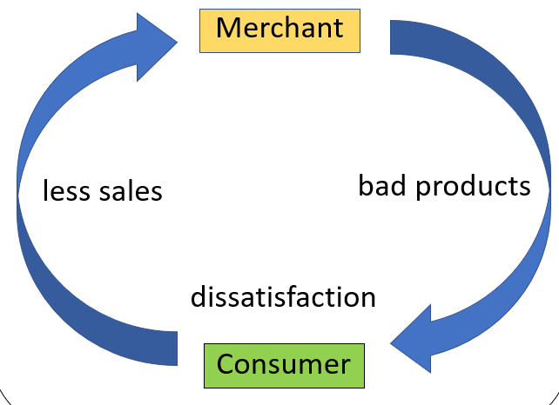
Research = Search for Alternatives
Disappointing sale → search for alternatives.
Locates Better Merchant
Consumer
More Happiness

Slide 29
Costs/Benefits of Research
 | Cost | Benefit | Quantity
Private Sector (Non-interactive) | 100% | 100% | Efficient
Public Sector (Interactive) | 100% | ~ 0 % | Shortage
71% of Americans can’t even name their Congressional Representative (Delli-Carpini and Keeter (1997)) Let alone: rival candidates, or policies or their effects.

Slide 30
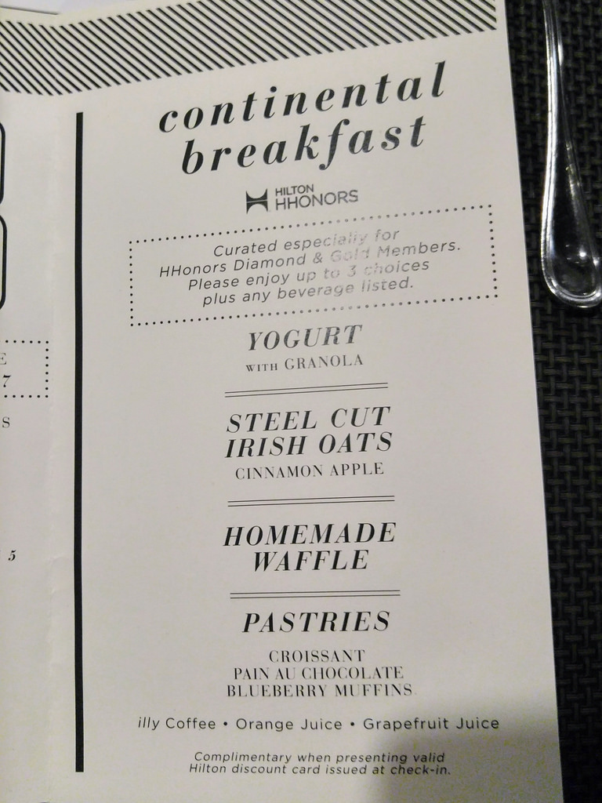

Slide 31

Educating People = Won’t Solve Problem
Worth Doing? Yes.
But: Layperson = NOT an expert specialist, by definition.
Specialists (Outvoted)

Slide 32
Agenda
Background
Electoral Feedback
Event Derivatives
Synthesis
Why Laypeople Will Care

Slide 33
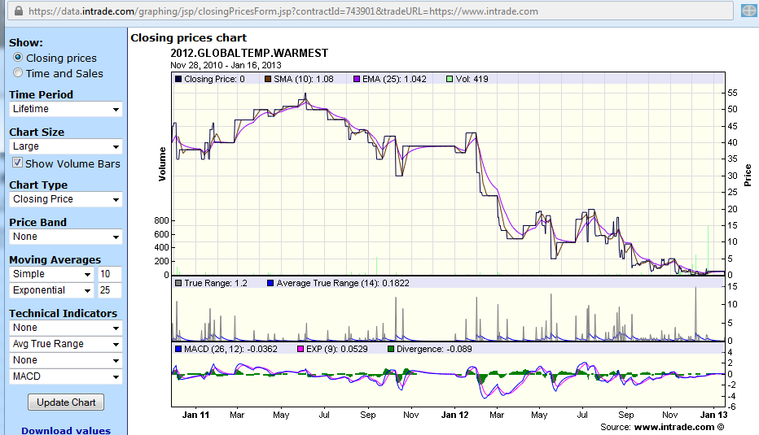
Event Derivative (InTrade.com) - 2012 global warming (also called a “prediction market”)
Worth $100 if 2012 is the warmest year on record.
Ran from Jan 2011 to End of 2012

Slide 34
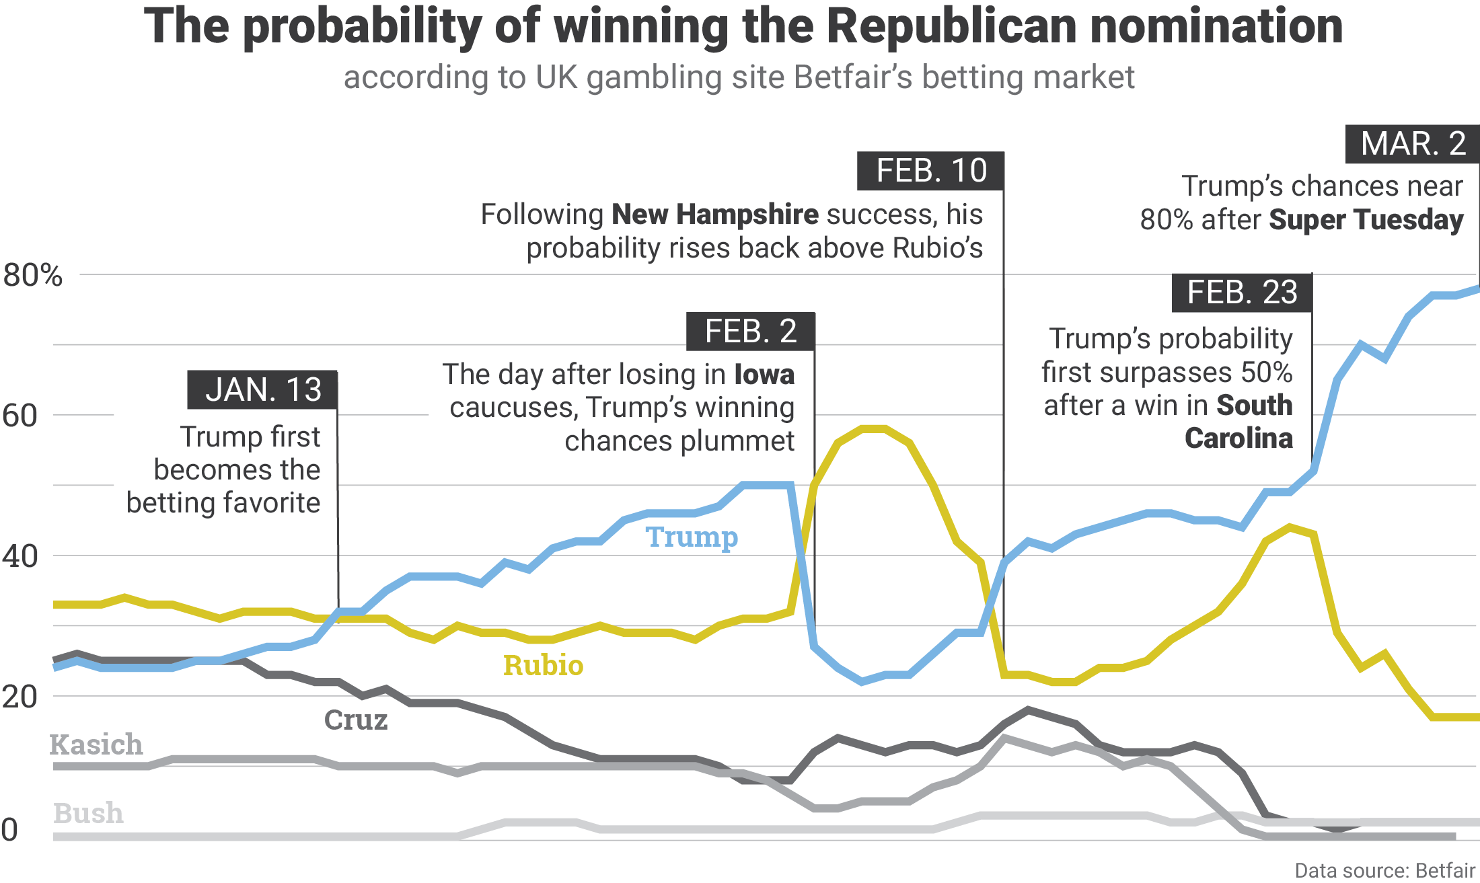
Betting on who will win
Graphic from NationalJournal.com

Slide 35
Betting on who will win
No
Graphic from NationalJournal.com

Slide 36
Nine Slides on Multivariate Betting

Slide 37
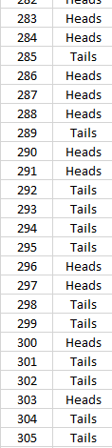
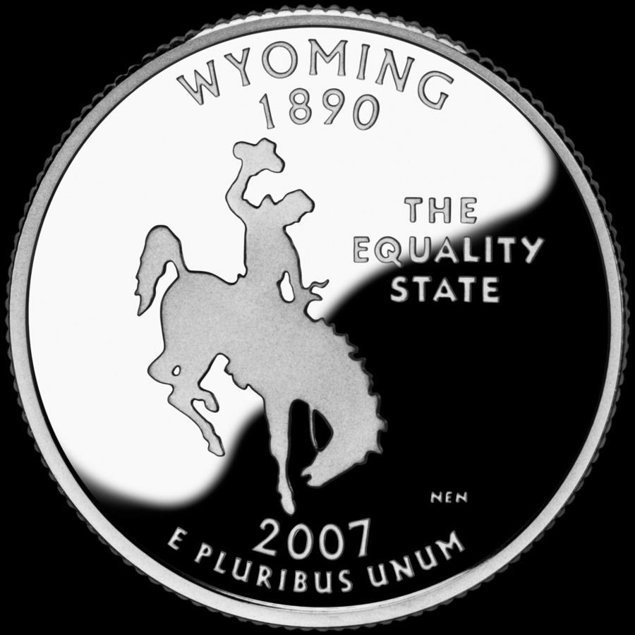
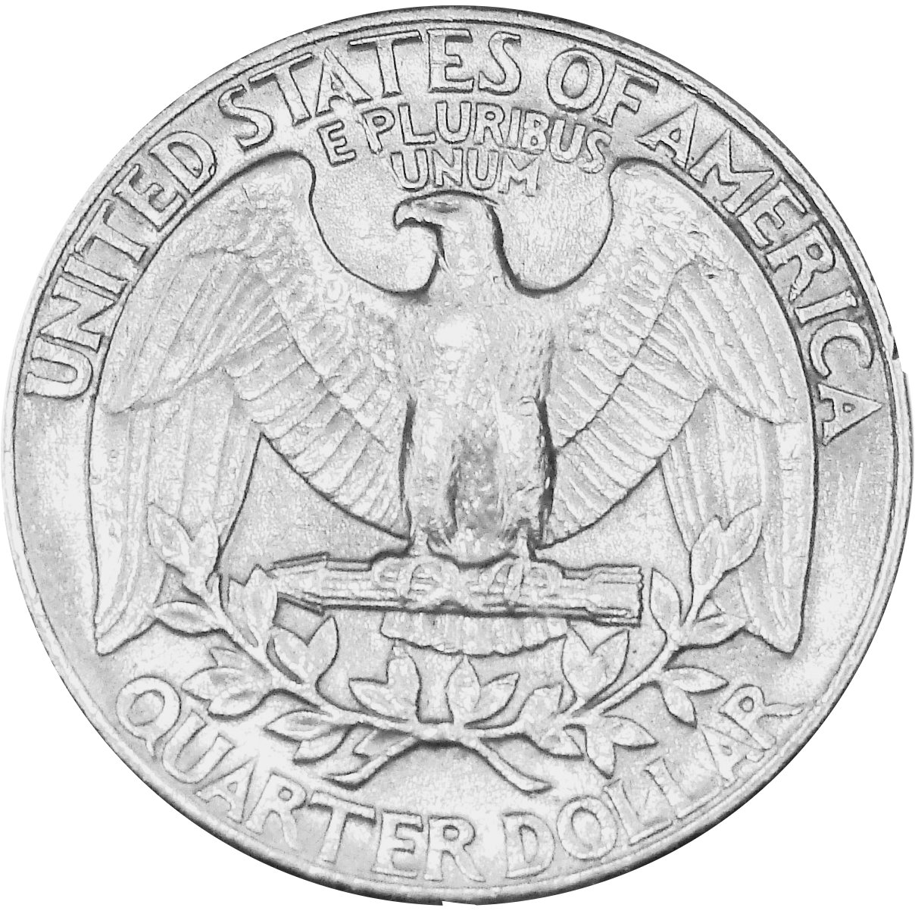
(1/9) Probability -- Review
Some future event (coin flip).
Heads has 50% likelihood.
Tails has 50% likelihood.
H | .50
T | .50
Coin Flip #303
1.00
Total probabilities add up to 100%.
Notes:
I need to explain conditional probability, in order to continue explaining this project. So I will now do that across nine slides. But the first two are super-easy, and four of them are really just one slide, broken into four pieces. So, this “math part” will be over soon, don’t worry.
Here, on the left I have a column of coin-flip events. We’re describing the behavior of the three-hundred-and-third coin flip. We don’t know what will happen on that flip, but we can nonetheless fill in the probabilities in this table. Heads and Tails are equally likely so its 50-50.

Slide 38
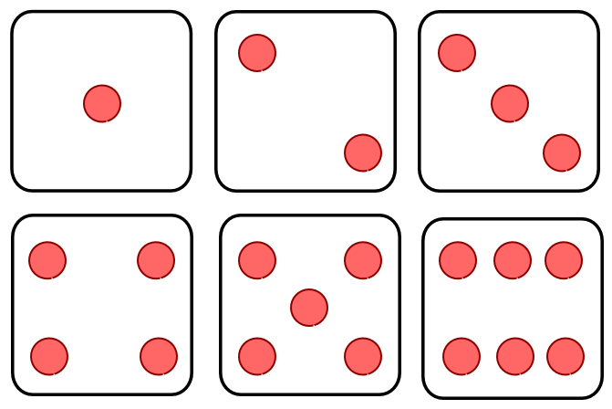
(2/9) Probability -- Review
Some future event (dice roll).
(1) | 1/6
(2) | 1/6
(3) | 1/6
(4) | 1/6
(5) | 1/6
(6) | 1/6
Each outcome has one-sixth likelihood.
Dice Roll #1190
1.00
Notes:
Now, this slide is the same as the previous one. But it has a dice roll instead of a coin toss. Each side of the dice is equally likely to come up, each has one-sixth probability.

Slide 39
(3/9) – Two Random Events, Taken Together
Dice Roll #1190
Coin Flip #303
 | (1) | (2) | (3) | (4) | (5) | (6)
H | 1/12 | 1/12 | 1/12 | 1/12 | 1/12 | 1/12
T | 1/12 | 1/12 | 1/12 | 1/12 | 1/12 | 1/12
“margin”
.50 | .50
.50
.50
1/6 | 1/6 | 1/6 | 1/6 | 1/6 | 1/6
1.00
Rolling a two AND flipping a tails.
“margin”
Rolling a two.
Flipping a tails.
Notes:
Now here we go, three of seven… This example, is the previous two examples, smushed together. We have the coin flip in green along the left vertical edge of the table. We have the dice roll across the top horizonal edge. I’ve circled some probabilities in red. The probability that two will be rolled, is one-sixth. The probably that a tail will be flipped, is one-half. Those are called marginal probabilities because they’re written in the margin, so to speak. The probability that BOTH a two will be rolled, and a tail will be flipped, is shown here as one-twelfth.

Slide 40
(4/9) -- Conditional Probability Taught Quickly
Coin Flip #304
 | H | T
H | .25 | .25
T | .25 | .25
Coin Flip #305
Two coins.
Coin Flip #304
 | H | T
H | ? | ?
T | ? | ?
The same event
(#304 x #304)
(not realistic)!
Coin Flip #304
 | 1 | 2 | 3 | 4 | 5 | 6
1 | ? | ? | ? | ? | ? | ?
2 | ? | ? | ? | ? | ? | ?
3 | ? | ? | ? | ? | ? | ?
4 | ? | ? | ? | ? | ? | ?
5 | ? | ? | ? | ? | ? | ?
6 | ? | ? | ? | ? | ? | ?
The same dice.
Notes:
Now, we’ll talk about relationships among events. Let me draw a contrast between these two blue tables here. Both are about unknown future coin flips. The top table considers coinflip three-zero-four, in blue across the top. And it considers flip number three-ohh-five, in red across the left side. Each cell will occur with probability point two five, which is what I have indicated here. The second table does something extremely unrealistic, and only useful for teaching purposes. It plots coin-flip #304 against itself. Again, in the real world, this would never happen. But, if it did happen, what probabilities would we write in this table?

Slide 41
(5/9) -- Conditional Probability Taught Quickly
Coin Flip #304
 | H | T
H | .25 | .25
T | .25 | .25
Coin Flip #305
Two coins.
Coin Flip #304
 | H | T
H | .50 | 0
T | 0 | .50
The same event
(#304 x #304)
(not realistic)!
Coin Flip #304
 | 1 | 2 | 3 | 4 | 5 | 6
1 | ? | ? | ? | ? | ? | ?
2 | ? | ? | ? | ? | ? | ?
3 | ? | ? | ? | ? | ? | ?
4 | ? | ? | ? | ? | ? | ?
5 | ? | ? | ? | ? | ? | ?
6 | ? | ? | ? | ? | ? | ?
The same dice.
Notes:
Here’s the answer. Coin flip three-zero-four, can either be heads or tails. But it has to be one or the other. So we zero out everything that’s impossible.

Slide 42
(6/8) -- Conditional Probability Taught Quickly
Coin Flip #304
 | H | T
H | .25 | .25
T | .25 | .25
Coin Flip #305
Two coins.
Coin Flip #304
 | H | T
H | .50 | 0
T | 0 | .50
The same event
(#304 x #304)
(not realistic)!
Coin Flip #304
Dice Roll #4011
 | 1 | 2 | 3 | 4 | 5 | 6
1 | ? | ? | ? | ? | ? | ?
2 | ? | ? | ? | ? | ? | ?
3 | ? | ? | ? | ? | ? | ?
4 | ? | ? | ? | ? | ? | ?
5 | ? | ? | ? | ? | ? | ?
6 | ? | ? | ? | ? | ? | ?
The same dice roll
(again, unrealistic!).
Dice Roll #4011
Notes:
Almost done teaching conditional probability. This time with dice instead of coins.
Same dice roll, #4011. We don’t know what it is.

Slide 43
(7/9) -- Conditional Probability Taught Quickly
Coin Flip #304
 | H | T
H | .25 | .25
T | .25 | .25
Coin Flip #305
Two coins.
Coin Flip #304
 | H | T
H | .50 | 0
T | 0 | .50
The same event
(#304 x #304)
(not realistic)!
Coin Flip #304
Dice Roll #4011
 | 1 | 2 | 3 | 4 | 5 | 6
1 | (1/6) | 0 | 0 | 0 | 0 | 0
2 | 0 | (1/6) | 0 | 0 | 0 | 0
3 | 0 | 0 | (1/6) | 0 | 0 | 0
4 | 0 | 0 | 0 | (1/6) | 0 | 0
5 | 0 | 0 | 0 | 0 | (1/6) | 0
6 | 0 | 0 | 0 | 0 | 0 | (1/6)
The same dice roll
(again, unrealistic!).
Dice Roll #4011
Notes:
It’s one-sixth, across the diagonal, and the rest zeros.

Slide 44
(8/9) “Clumping” = Related
Coin Flip #304
 | H | T
H | .50 | 0
T | 0 | .50
Coin Flip #304
Will Candidate X be Elected?
 | Yes | No
Yes | .50 | 0
No | 0 | .50
Will American Voters Earn Higher Incomes?

Slide 45
(9/9) Synthesis – Just Four Different Event-Derivative Markets
Will Candidate X be Elected?
 | Yes | No
Yes | .50 | 0
No | 0 | .50
Will American Voters Earn Higher Incomes?

Slide 46
Agenda
Background
Electoral Feedback
Event Derivatives
Synthesis
Why Laypeople Will Care

Slide 47
Basic Arithmetic
“Good Economy” in 2021
( <5% Unemployment )?
“Good Economy” (Conditional Likelihood)
Yes
No
Someone Else
0.0005 | 0.0005 | 0.001
.42 | .19 | .61
.23 | .15 | .38
.00 | .009 | .009
.6505 | .3495
50%
31%
39%
100%
Nov 2020 Election Winner
Democrat
Republican
Elon Musk

Slide 48
Voter Sees on Election Morning (For Example):
Average, over years 2020-2024… | Incumbent Party | Rival Party
Total Government Spending ($/person) | $12,568 | $10,407
Total Money Earned by all Citizens ($ billions) | $16,427 | $17,009
Total Deaths, all causes (thousands of people) | 2,917 | 2,901
better
Slightly better
basically the same

Slide 49
Agenda
Background
Electoral Feedback
Event Derivatives
Synthesis
Why Laypeople Will Care
Notes:
Well, of course, there’s no knowing for sure.

Slide 50
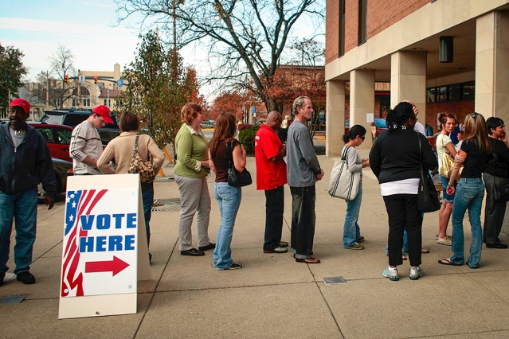
Why would laypeople check their phones on election day?
“Small ask”.
Accuracy will remain high, and that people gradually become more interested.
The election process is so broken, and distasteful (ie, attack ads), that people will come around eventually.
Aim especially for Congressional elections where impact is high, voters least informed.
Consider how low the voter turnout rate is. And how low the margins are. Task is actually quite easy.
Photo from MIT.edu
Notes:
Checking the phones is, of course, a very small ask – these people will be waiting in line to vote; and they’ll be glued to their phone the whole time anyway.

Slide 51
Why would laypeople check their phones on election day?
“Small ask”.
Accuracy will remain high, and that people gradually become more interested.
The election process is so broken, and distasteful (ie, attack ads), that people will come around eventually.
Aim especially for Congressional elections where impact is high, voters least informed.
Consider how low the voter turnout rate is. And how low the margins are. Task is actually quite easy.
Already on phone!
Photo from MIT.edu
Notes:
Checking the phones is, of course, a very small ask – these people will be waiting in line to vote; and they’ll be glued to their phone the whole time anyway.

Slide 52
Why navigate phone to these prices? Why not just ignore them (as usual)?
Consider how low the voter turnout rate is. And how low the margins are. Task is actually quite easy.
Event-derivative accuracy will remain high. People will gradually become more interested.
Metrics that cannot be corrupted in the long term.

Slide 53
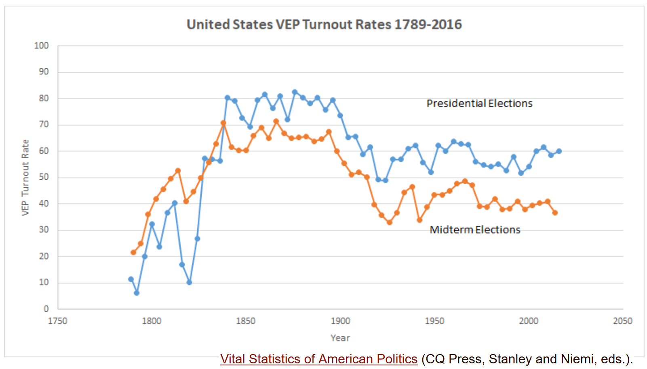
Low Voter Turnout
Notes:
…and most people don’t even vote at all. More than enough to swing it one way or another.

Slide 54
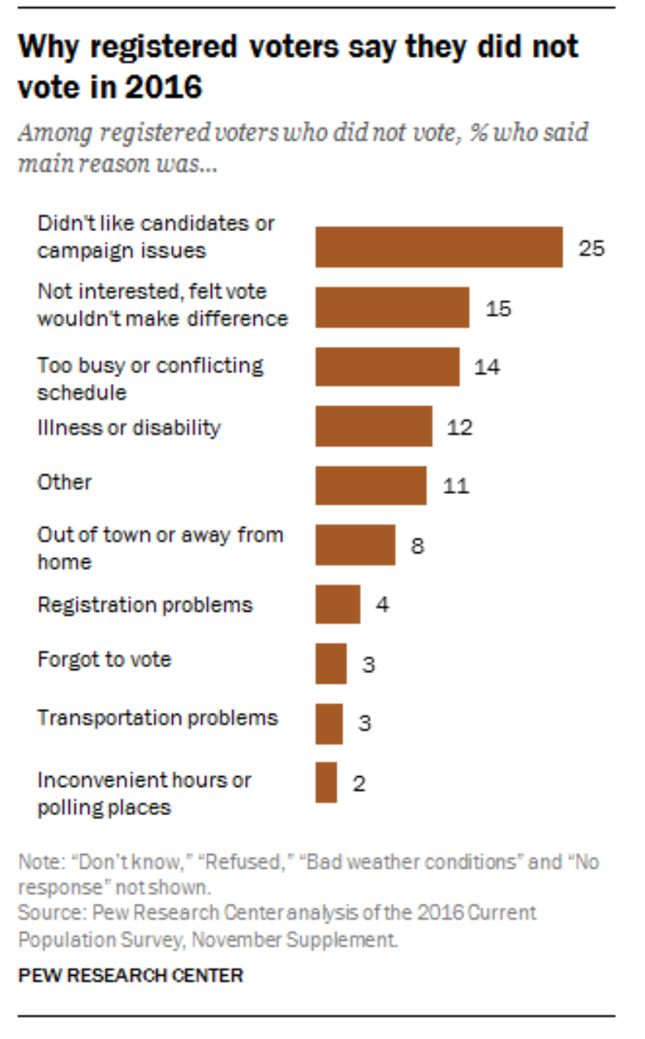
Why Turnout Low: Voters Admit Feeling Overwhelmed
Notes:
When you ask people why they don’t vote, at least a third of them will admit it is because they don’t know what to do.

Slide 55
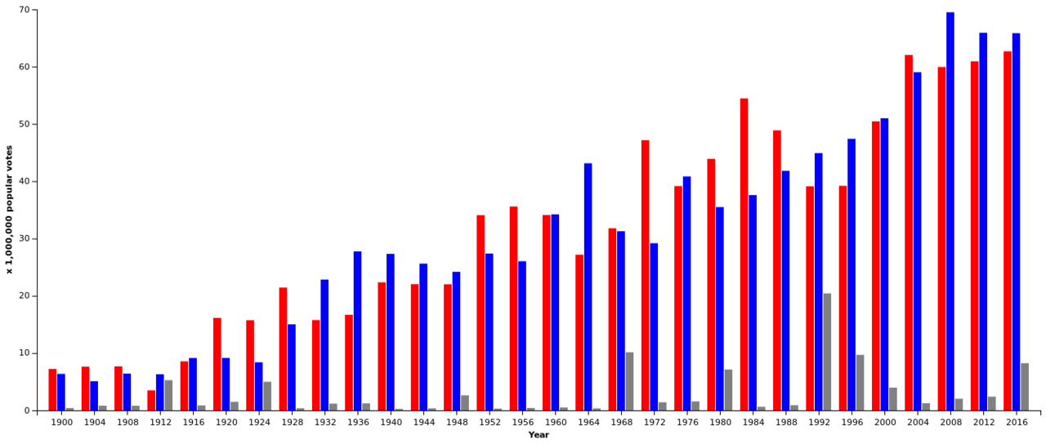
Popular Vote – Victory Margins Are Very Narrow
Presidential Popular Vote
Wikipedia Commons
Notes:
Basically, elections are usually pretty close…

Slide 56
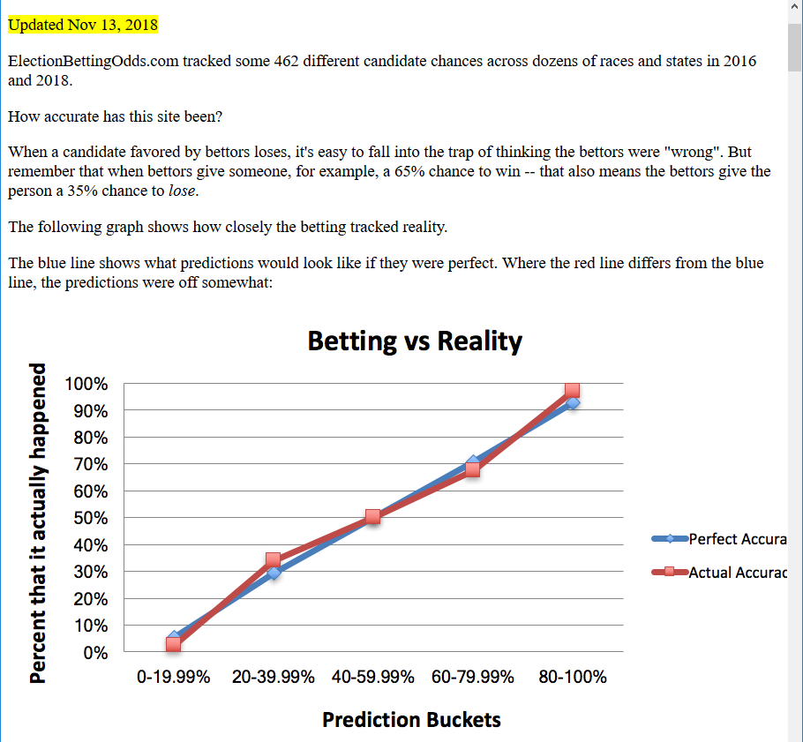

Slide 57
“Ramp it up” Lowbrow → Highbrow
Sports (SuperBowl, March Madness)
E-Sports
Arts (Oscars, Tonys).

Slide 58
Last Slide: Here, Politician Rhetoric Is Irrelevant
As this idea becomes influential, politicians will start competing on these metrics.
But in order for their numbers to go up, they’ll need to actually hit the target in reality.
For example: Politician could announce that they want everyone to die, and plan to kill everyone, but unless traders believe that the politician can follow through with this plan, the ‘deaths’ numbers won’t budget an inch.
Layperson already knows that politicians are liars. (Will prefer this.)

Slide 59
Thank You!
Questions?

Slide 60
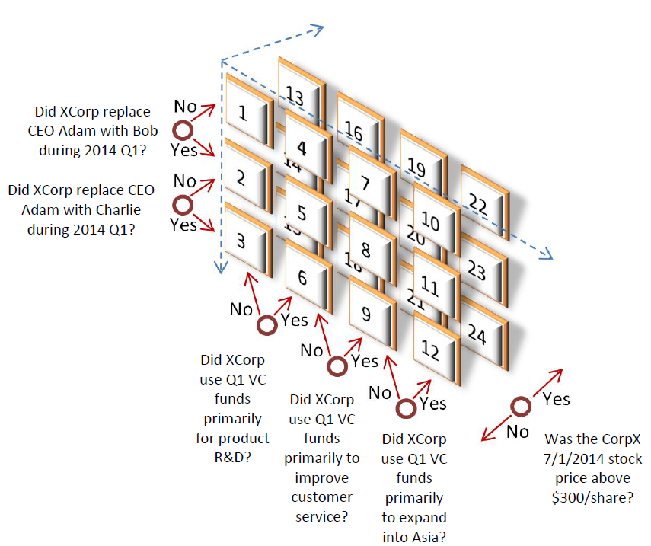
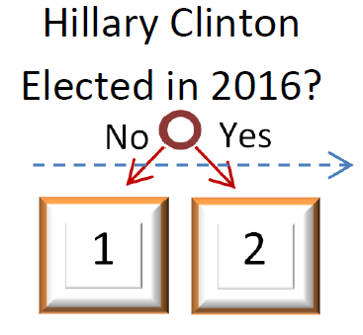
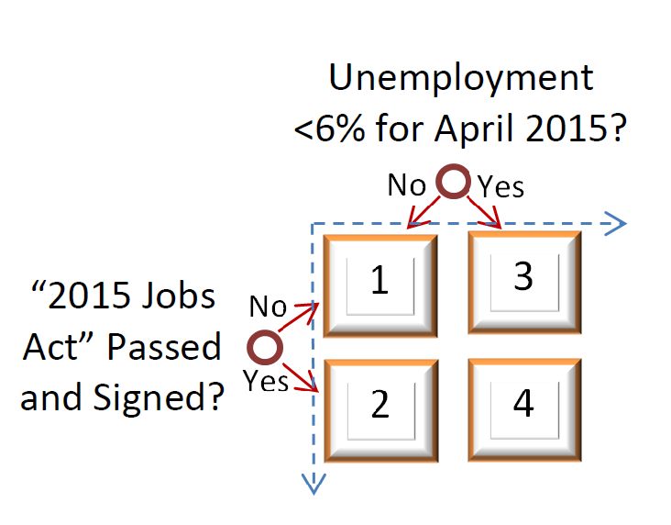
Conditional Forecasts: More Than One Dimension
Liquidity?
3
1
2
Too many assets (24?!) Will people really buy/sell each?

Slide 61
Permanent Liquidity (via MSR)
No “offers” – Ie, No Bids/Asks.
No interaction between buyer/seller. (Instead, traders interact w/ protocol.)
No “limbo”
Usual Way (“Double Auction” Market)
New Way (“Scoring Rule” Market)
Trader 2
Trader 2
Create
Observe buy wall
Submits “accept bid”
Sell transaction complete
Create
Deposit “sacrificial cash”
Market
Market
Market
Market
Market
Buy transaction complete
Buy assets
Sell assets
Market exists
Submit bid
Trader 1
Trader 1
Trader 1
Better for:
Zero-sum derivatives
Blockchains
Trader 1
“limbo”

Slide 62
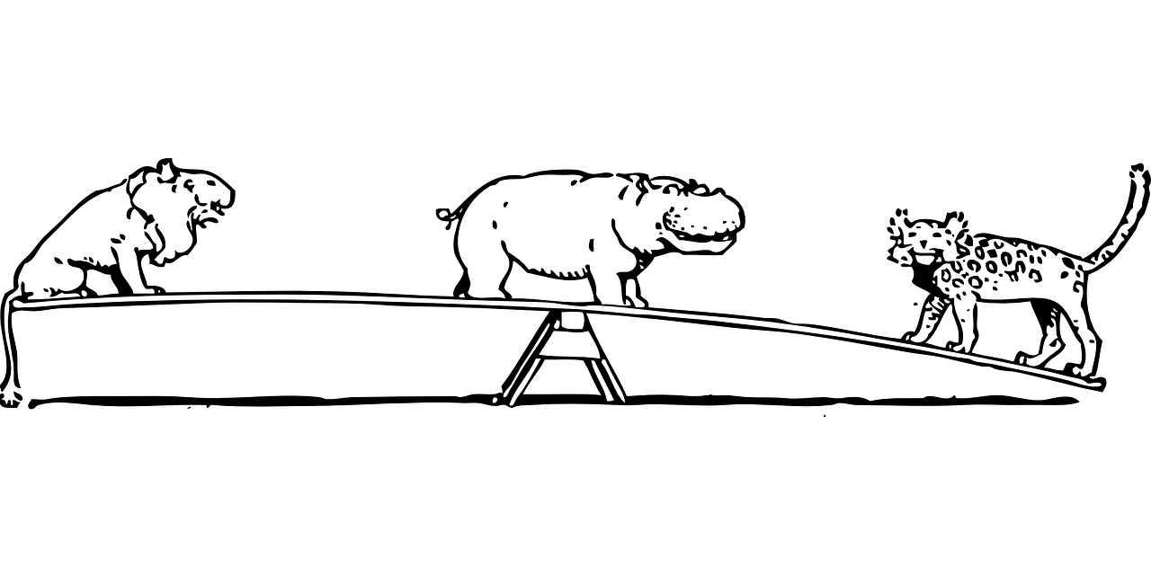
See-Saw Metaphor
Sacrificial ‘startup’ money placed in center.
Trader buys shares (of “no”, by putting money on left side).
Trader buys shares (of “yes” by putting money on right side).
Traders sell by depositing shares and removing money from the see-saw.
At the end, all money (incl. “hippo” money) goes to the winner.
Current price of “No”
0.00
0.00
0.50
0.50
No
1.00
Yes
1.00
Thanks pixabay for free images.
Notes:
First, some sacrificial startup money is placed in the center. These people will be compensated with market trading fees later, but for now just assume that it charitably appears there.
This is the hippo money. Second, traders buy and sell shares. They buy, by putting money onto the see-saw. SO this is the lion money and the tiger money.
If you place money on the lion space, the protocol automatically dispenses the appropriate amount of shares. The more money already on the space, the fewer shares you get. If the see-saw is way up, when you put money on it, then you get more shares per dollar. If the see saw is all the way down, you get fewer shares per dollar. Notice that visually, the price is reversed here – more money bet on No, means that the price is higher – its more toward 1.00 instead of 0.00.
So the share “price” is always known. And you can always buys/sell at this price.
At the end, whoever wins the bet, will collect all of the money, including the sacrificial hippo money. You get rewarded in proportion to how many shares you own.

Slide 63
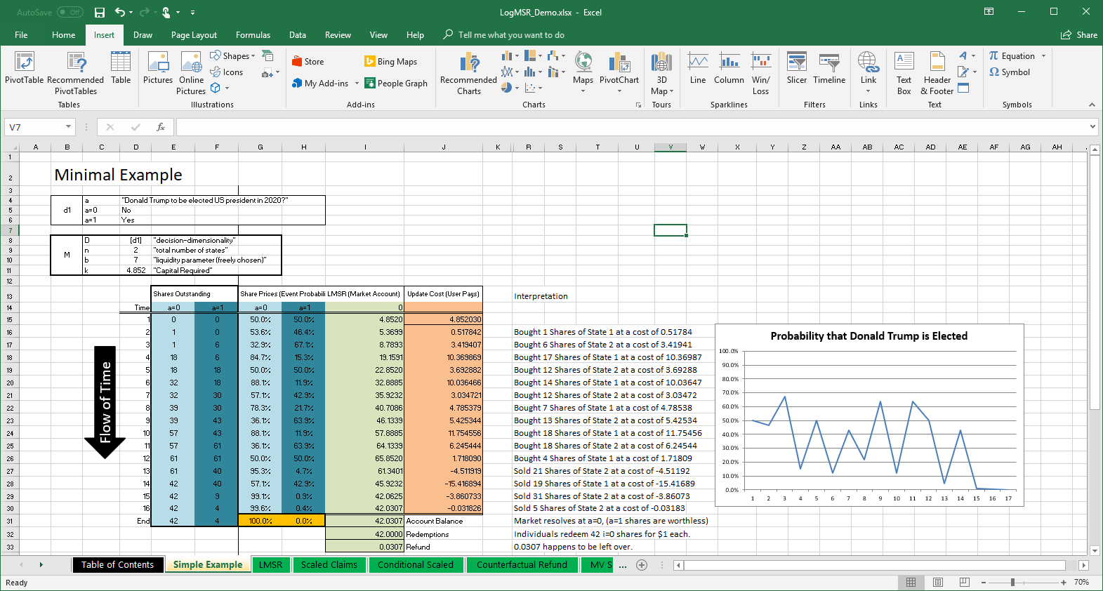
Permanent Liquidity
No “offers” – Ie, No Bids/Asks.
No interaction between buyer/seller.
Instead, traders interact w/ protocol.
Full collateralization.
Notes:
Here’s what it looks like in practice. This is a table describing the market’s state, as it changes over time. It starts out with zero trades and zero shares issued. But the creator of the market also starts it out with some sacrificial cash – in this case – there is 4.85 of sacrificial in an account (in this case).
Then, in the second row at time=2, someone buys a share of “No”, the left column. They have to pay 0.5178 into the account in order to buy that share – that’s the orange column. The account then has 5.3699 – that’s the olive green column in the middle. Then a different person buys 6 shares of “Yes”, the darker-blue column. This cost them 3.4, and the account now has 8.78. Then a bunch of buying and selling activity happens. At the end the account has 42 in it, which is just enough to pay all of the 42 winning shares in full. The math is such that the account always has enough money, no matter what happens.

Slide 64
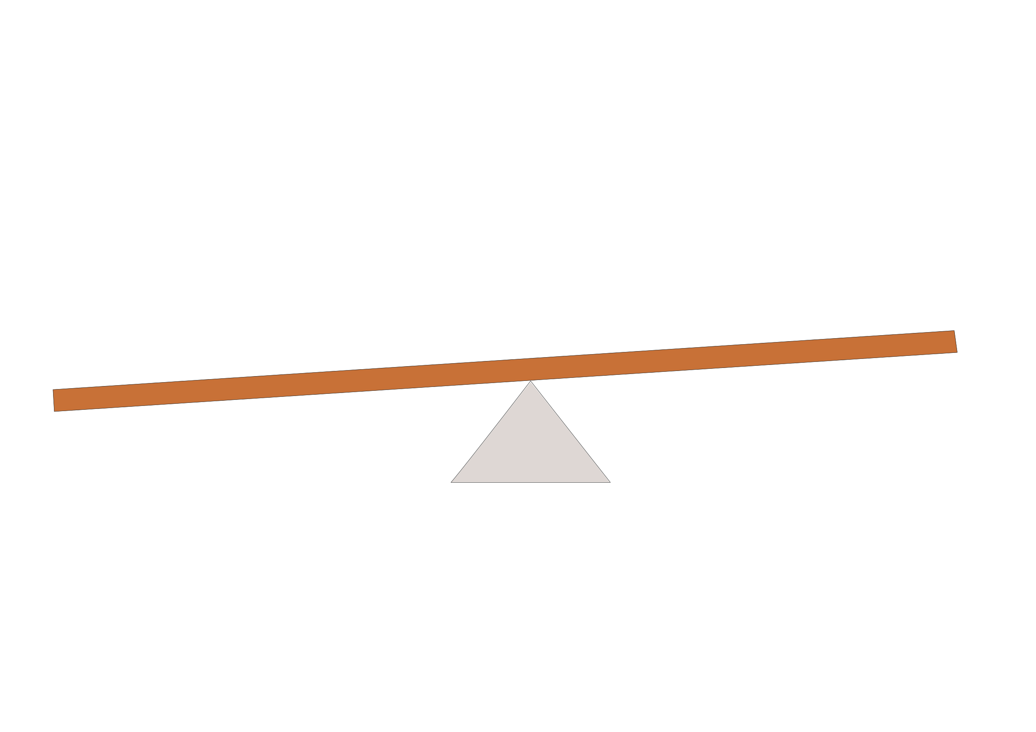

See-Saw → Tray
18
13
4
12
24
11
2
2
10
1
1
1
2
4
6
3
2 states
4 states
n states
Notes:
The math is also completely indifferent to the number of states. So instead of a two-person see-saw, we could use a four person see-saw, on one fulcrum. It works exactly the same way. And in fact we can use a see-saw of an unlimited number of people, arranged in a circle. You have to imagine a kind of plate, or circular tray, that is suspended on a pin in the center.

Slide 65
In general, the liberty movement struggles with being persuasive. But, we do have a disproportionate number of wealthy people, and/or people who are just good with money. Good savers.
Way to turn money → healthier, more liquid, more popular market, more fun market. → more accuracy.
Credibility bolster by the objective fact that contributions do not endorse any single outcome at the expense of others.
Appealing to Third-Parties … usual suspects (virtue signalers / people who think they are right).
How much is donated to other projects?
Annenberg “FactCheck.org” roughly 1 million per year.

Slide 66
Skyhooks
Persuasion
Switching Voting
Some kind of (one-time) revolution

Slide 67
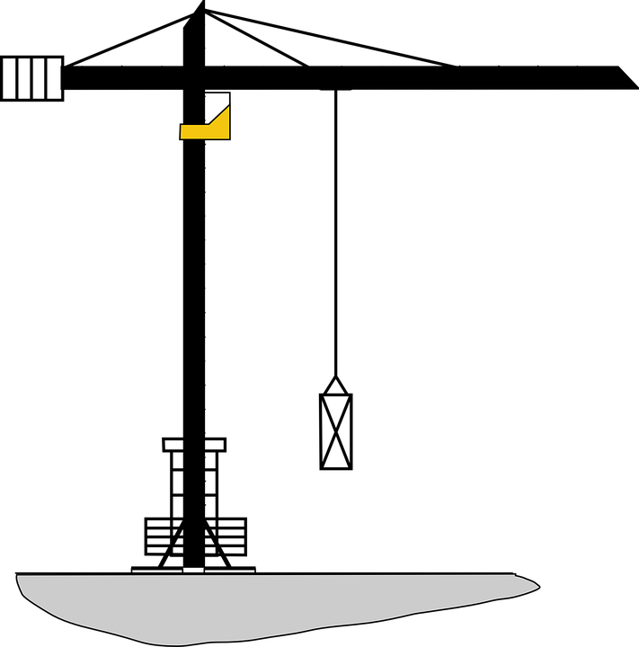
Crane. Not Skyhook
Crane
Skyhook
Lift via: Physics Xfers weight to different part of ground.
Lift via: Magic Unexplained force.
Notes:
Also, this idea is a crane, not a skyhook. What does that mean?
Well, this is a crane. It lifts objects off the ground, by transferring their weight to some …place that is less inconvenient. And..

Slide 68
Crane. Not Skyhook
Crane
Skyhook
Lift via: Physics Xfers weight to different part of ground.
Lift via: Magic Unexplained force.
Notes:
…this is a skyhook. It lifts by magic, or some unexplained force. It is a fictional and naïve idea. It assumes that something else will solve your problem for you. Now, my point here is that…

Slide 69
Crane. Not Skyhook
Things other people do. (Actually they wont do them.)
Crane
Skyhook
What we do.
Our Problem
Everything that needs to change, we can do unilaterally.
Lift via: Physics Xfers weight to different part of ground.
Lift via: Magic Unexplained force.
Notes:
…in this idea, the things that we do, will solve the problem. In contrast, other ideas –in the liberty movement– are skyhooks. They rely on other people. Ironically. Which is why they won’t work – they’re the magic. I’ll get back to this later.

Slide 70
Crane
Skyhook
Notes:
…this is a skyhook. It lifts by magic, or some unexplained force. It is a fictional and naïve idea. It assumes that something else will solve your problem for you. Now, my point here is that…

